Slide 1
PRODIGY
Power Up Your Grammar
Academic Instructor
Dr. Meirav Taieb-Maimon
By Guy Manzurola
Notes:
Prodigy is a game based learning tool for English grammar

Slide 2


The Problem: Keeping Learners Motivated
The Solution:
Create an e-learning tool using design principles from computer games.

Slide 3
Design and Architecture
Server: Java Servlets, Jersey for a RESTful architecture, Hiberante as ORM. Single REST entry point to application. “Query Module”.
Database: Mysql.
Client: HTML5. Built a small VM framework (pure JS).

Slide 4
HTML5
(JavaScript, CSS3)
Top Tier
Client
AJAX
JSON
HTTP GET
REST
Tomcat 7
REST Resources
Model Entities
Middle Tier
Server
Hibernate ORM
Hibernate
Tomcat Managed Connection Pooling
MySQL Database
Bottom Tier
Database

Slide 5
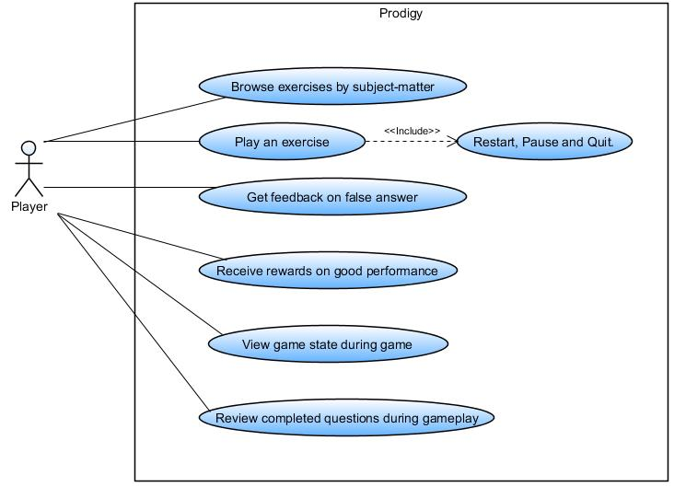
Use Cases

Slide 6
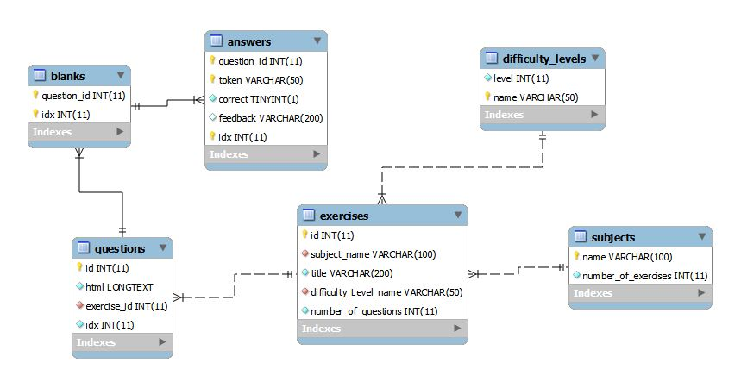
Database

Slide 7
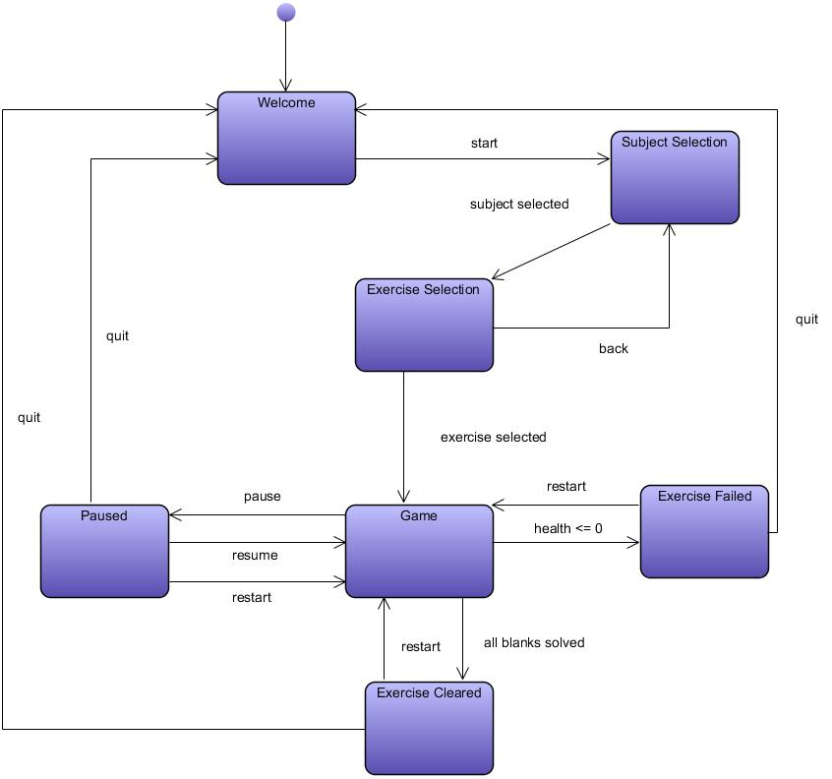
Screen Layout

Slide 8
Pending QA Tests
Use case testing in a production environment.
Input/output testing of server module.

Slide 9
Pending Experiments
Usability / Web Usability
Motivation increase as a result of using the tool.

Slide 10
FIN
GOOD LUCK!

